Slide 1
jQuery
The Way to JavaScript and Rich Internet Applications

Slide 2
Introduction to jQuery
Developed by John Resig at Rochester Institute of Technology
“jQuery is a lightweight JavaScript library that emphasizes interaction between JavaScript and HTML. It was released in January 2006 at BarCamp NYC by John Resig.”
“jQuery is free, open source software Dual-licensed under the MIT License and the GNU General Public License.”
“It’s all about simplicity. Why should web developers be forced to write long, complex, book-length pieces of code when they want to create simple pieces of interaction?”
Current version is 1.3.2.
Version 1.4 due out soon.

Slide 3

John Resig
John Resig is a JavaScript Tool Developer for the Mozilla Corporation and the author of the book Pro JavaScript Techniques. He's also the creator and lead developer of the jQuery JavaScript library.
Currently, John is located in Boston, MA. He's hard at work on his second book, Secrets of the JavaScript Ninja, due in bookstores in 2009.
Microsoft and Nokia have announced plans to bundle jQuery on their platforms,[1] Microsoft adopting it initially within Visual Studio[2] for use within Microsoft's ASP.NET AJAX framework and ASP.NET MVC Framework whilst Nokia will integrate it into their Web Run-Time platform.

Slide 4
Introduction to jQuery
Why do I want it
  Rich Internet Applications (RIA)
  Dynamic HTML (DHTML)
How do I get it
  www.jquery.com
How can I learn it
  jQuery in Action by Bibeault & Katz, Manning
  jQuery Visual Quickstart Guide by Holzner, Peachpit
  www.jquery.com
  docs.jquery.com
  www.visualjquery.com
  www.Jqueryfordesigners.com
  www.gscottolson.com/weblog/ - cheat sheet
  www.javascripttoolbox.com/jquery

Slide 5
Plan for the 4 sessions
Class I – Introduction, installation, “Howdy World”, Ready function, DOM, Selecting and Formatting web page elements
Class II – Events and Animations
Class III – jQuery Plugin libraries
Class IV – AJAX with PHP and ASP.NET

Slide 6
Introduction to jQuery
Installation – You just download the jquery-1.3.2.js file and put it in your website folder
  Can access via URL

Slide 7
What jQuery Does
“Unobtrusive” JavaScript – separation of behavior from structure
CSS – separation of style from structure
Allows adding JavaScript to your web pages
Advantages over just JavaScript
  Much easier to use
  Eliminates cross-browser problems
HTML to CSS to DHTML

Slide 8
5 Things jQuery Provides
Select DOM (Document Object Model) elements on a page – one element or a group of them
Set properties of DOM elements, in groups (“Find something, do something with it”)
Creates, deletes, shows, hides DOM elements
Defines event behavior on a page (click, mouse movement, dynamic styles, animations, dynamic content)
AJAX calls

Slide 9
The DOM
Document Object Model
jQuery is “DOM scripting”
Heirarchal structure of a web page
You can add and subtract DOM elements on the fly
You can change the properties and contents of DOM elements on the fly

Slide 10
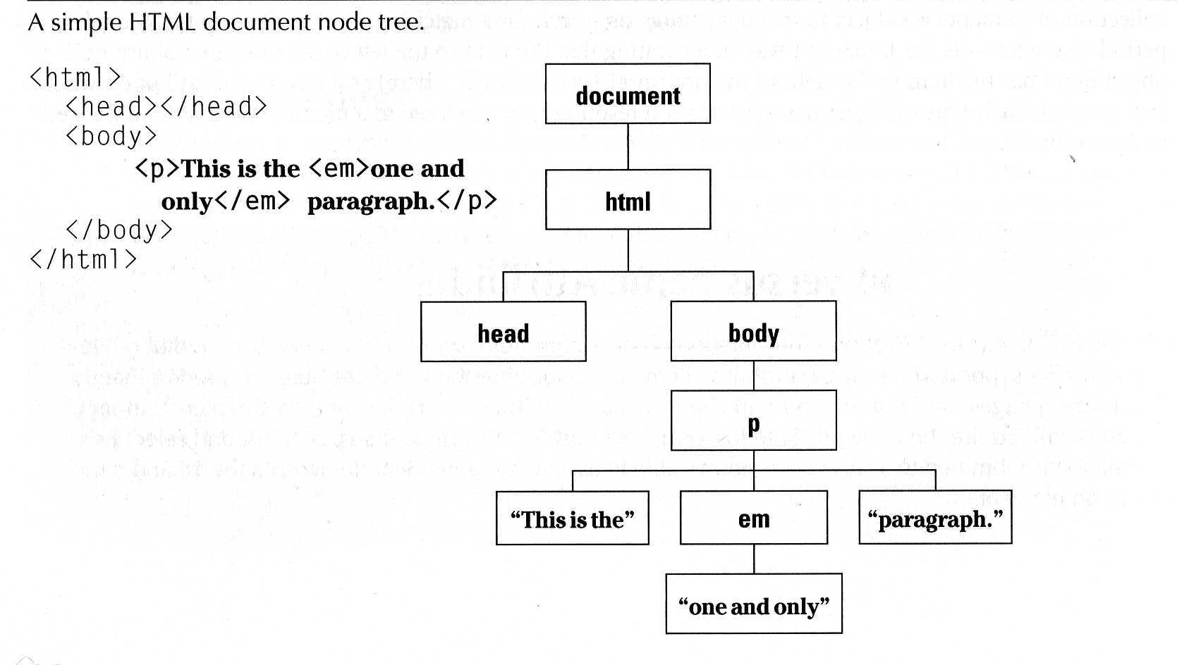
The DOM
“The Document Object Model (DOM) is a cross-platform and language-independent convention for representing and interacting with objects in HTML, XHTML and XML documents. Aspects of the DOM (such as its "Elements") may be addressed and manipulated within the syntax of the programming language in use.” Wikipedia

Slide 11
The jQuery Function
jQuery() = $()
$(function) The “Ready” handler
$(‘selector’) Element selector expression
$(element) Specify element(s) directly
$(‘HTML’) HTML creation
$.function() Execute a jQuery function
$.fn.myfunc(){} Create jQuery function

Slide 12
Tutorial 1 – The Ready Function
Set up a basic HTML page and add jQuery
Create a “ready” function
Call a function
5 ways to specify the ready function
  jquery(document).ready(function(){…};);
  jquery().ready(function(){…};)
  jquery(function(){…};)
  jquery(dofunc);
  $(dofunc);

Slide 13
Tutorial 2 – Selecting Elements
Creating a “wrapped set”
$(selector)
selector:
  $(‘#id’) id of element
  $(‘p’) tag name
  $(‘.class’) CSS class
  $(‘p.class’) <p> elements having the CSS class
  $(‘p:first’) $(‘p:last’) $(‘p:odd’) $(‘p:even’)
  $(‘p:eq(2)’) gets the 2nd <p> element (1 based)
  $(‘p’)[1] gets the 2nd <p> element (0 based)
  $(‘p:nth-child(3)) gets the 3rd <p> element of the parent. n=even, odd too.
  $(‘p:nth-child(5n+1)’) gets the 1st element after every 5th one
  $(‘p a’) <a> elements, descended from a <p>
  $(‘p>a’) <a> elements, direct child of a <p>
  $(‘p+a’) <a> elements, directly following a <p>
  $(‘p, a’) <p> and <a> elements
  $(‘li:has(ul)’) <li> elements that have at least one <ul> descendent
  $(‘:not(p)’) all elements but <p> elements
  $(‘p:hidden’) only <p> elements that are hidden
  $(‘p:empty’) <p> elements that have no child elements

Slide 14
Selecting Elements, cont.
$(‘img’[alt]) <img> elements having an alt attribute
$(‘a’[href^=http://]) <a> elements with an href attribute starting with ‘http://’
$(‘a’[href$=.pdf]) <a> elements with an href attribute ending with ‘.pdf’
$(‘a’[href*=ntpcug]) <a> elements with an href attriute containing ‘ntpcug’

Slide 15
Useful jQuery Functions
.each() iterate over the set
.size() number of elements in set
.end() reverts to the previous set
.get(n) get just the nth element (0 based)
.eq(n) get just the nth element (0 based) also .lt(n) & .gt(n)
.slice(n,m) gets only nth to (m-1)th elements
.not(‘p’) don’t include ‘p’ elements in set
.add(‘p’) add <p> elements to set
.remove() removes all the elements from the page DOM
.empty() removes the contents of all the elements
.filter(fn/sel) selects elements where the func returns true or sel
.find(selector) selects elements meeting the selector criteria
.parent() returns the parent of each element in set
.children() returns all the children of each element in set
.next() gets next element of each element in set
.prev() gets previous element of each element in set
.siblings() gets all the siblings of the current element

Slide 16
Tutorial 3 – Formatting Elements
.css(property, value)
.html()
.val() (form elements)
.text()
.addClass(‘class’)
.removeClass(‘class’)

Slide 17
Tutorial 4 – Add Page Elements
$(‘#target’).before(‘<p>Inserted before #target</p>’);
$(‘#target’).after(‘<p>This is added after #target</p>’);
$(‘#target’).append(‘<p>Goes inside #target, at end</p>’);
$(‘#target’).wrap(‘<div></div>’);

Slide 18
Adding Events
Mouseover events – bind, hover, toggle
Button click events
Keystrokes

Slide 19
Event Background
DOM Level 2 Event Model
  Multiple event handlers, or listeners, can be established on an element
  These handlers cannot be relied upon to run an any particular order
  When triggered, the event propagates from the top down (capture phase) or bottom up (bubble phase)
  IE doesn’t support the “capture phase”

Slide 20
Basic Syntax of Event Binding
$(‘img’).bind(‘click’,function(event){alert(‘Howdy’;});
$(‘img’).bind(‘click’,imgclick(event));
  Allows unbinding the function
$(‘img’).unbind(‘click’,imgclick());
$(‘img’).unbind(‘click’);
$(‘img’).one(‘click’,imgclick(event));
  Only works once
$(‘img’).click(imgclick);
$(‘img’).toggle(click1, click2);
$(‘img’).hover(mouseover, mouseout);

Slide 21
Element Properties – “this”
this
this.id
this.tagName
this.attr
this.src
this.classname
this.title
this.alt
this.value (for form elements)

Slide 22
‘Event’ properties
event.target ref to element triggering event
Event.target.id id of element triggering event
event.currentTarget
event.type type of event triggered
event.data second parm in the bind() func
Various mouse coordinate properties
Various keystroke related properties

Slide 23
Event Methods
.stopPropagation() no bubbling
.preventDefault() no <a> link, no <form> submit
.trigger(eventType) does not actually trigger the event, but calls the appropriate function specified as the one tied to the eventType
.click(), blur(), focus(), select(), submit()
  With no parameter, invokes the event handlers, like trigger does, for all the elements in the wrapped set

Slide 24
Shortcut Event Binding
.click(func)
.submit(func)
.dblclick(func)
.mouseover(func)
.mouseout(func)
.select(func)

Slide 25
Useful Event Functions
.hide() display:true
.show() display:none
.toggle(func1, func2) first click calls func1, next click executes func2
.hover(over, out) mouseover, mouseout

Slide 26
AJAX
What is AJAX
The basic AJAX function – XMLHttpRequest
Initiating a request
Getting the response

